Slide 1
Biotechnology Companies and Infectious Disease
Devon Sherwood, Michael Deganich, Tyler Fulton

Slide 2
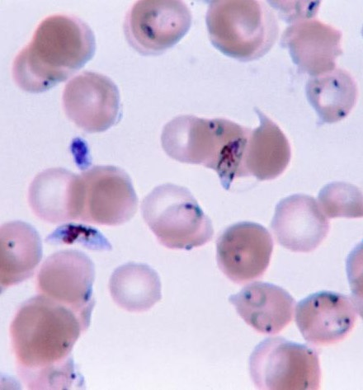
Malaria
Pharmaceutical company giant, GlaxoSmithKline (GSK), has decided to openly share its research with others globally.
Open innovation strategy set forth by GSK will help make better and cheaper medicines for poorer areas.

Slide 3
GSK is the first company ever to openly disclose the structures and compositions of many compounds.
GSK also sponsors the African Malaria Partnership and awards companies joining the partnership with 2.5 million dollars.
Some infectious diseases are very unique in how they are resistant to antibiotics, for example Malaria can be more resistant to certain treatment if it is contracted in one part of the world as opposed to another. Factors such as pregnancy, age, and general health also play into the effectiveness of malaria treating drugs.

Slide 4
Most companies seek to make a vaccine for Malaria from recombinant proteins obtained from infected mosquitoes.
Sanaria, under a National Institute of Allergy and Infectious Disease, NIAID, grant, is attempting to make a vaccine from a weakened form of the entire virus.

Slide 5
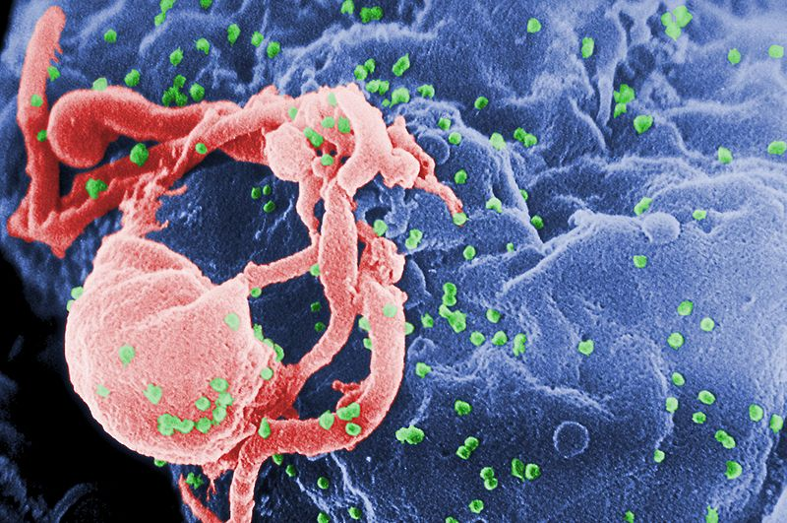
AIDS
Many biotech companies stepped back on work with AIDS. Many pressure groups have arisen and halted clinical trials of medications companies say can prevent HIV and fight the initial HIV infection.

Slide 6

"Biotech companies have spent all these years—and capital—getting this very complex science right to treat diseases in complex markets only to discover that their best efforts might not be good enough…“ –Steven Burril, CEO of Burril & Co. investment firm in San Francisco.

Slide 7
Many biotechnology companies in California have taken up the challenge, but so far are only able to transform the disease from a death sentence into a chronic problem.
As time progresses, medications for HIV/AIDS become less and less effective as patients become more resistant to it.
Currently there are 19 treatments available with 20 more in development.
Recent incentives toward the control of AIDS/HIV can be seen taking place in South Africa where teenage girls may possibly be rewarded with cash for good grades and by staying HIV-free. Since financial pressures might push young people to HIV-risky behavior cash incentives can help them in a number of ways.

Slide 8
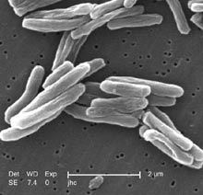
Tuberculosis
Tuberculosis, commonly referred to as TB, knows no borders and has attracted the attention of NIAID.
As a result of this, NIAID has established a global agenda to rid the world of TB.

Slide 9
Reemergence of TB and its extreme resistance to drugs has NIAID on the offensive.
Productive partnerships have been formed with private sector companies, government agencies, and Independent researchers.

Slide 10
RTI international has taken an initiative to bring a global cooperation of research labs, foundations, biotech companies, and international organizations.
Comparisons of specifications for current compounds on and off the market are being used to further the movement.

Slide 11
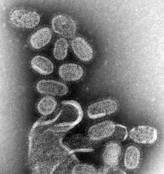
Influenza
As of June 30th, 2011, the Influenza vaccination created by Medicago is behaving as hoped and looks promising come flu season. The flu should be well under control with low mortality rates.

Slide 12
Strains of Influenza also have qualities like malaria however new strains appear every single year and thus new drugs have to be taken to combat the new strains. The “flu” as it is commonly called can last 7-10 days, and can possibly be prevented with a vaccine. Here are some CDC recommendations in dealing with influenza: http://www.cdc.gov/flu/about/qa/antiviral.htm

Slide 13
MRSA
Novbay, an American biotechnology company, partnered up with Galderma, S.A. of Sweden for a dermatological fight against MRSA.
In clinical trials 92% to 95% of patients were helped by the developing Aganocide technology with NVC-422 which mimics the body’s natural response to an infection and fights the MRSA virus.

Slide 14
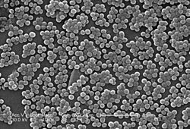
The companies also hope to manufacture a bacteria capable of consuming and degrading the MRSA virus “from the inside out”.
They believe their treatments for MRSA can be far more effective than any antibiotics.

Slide 15
Incentives For the Development of Treatments and Drugs to Combat the Spread of Infectious Diseases
Pediatric Treatments
  Children make up 40% of the World’s population, but little research is actually done towards childhood infectious diseases.
  Research that has been done shows that treatments successful in adult subject may not have the same effect in children.
  The Creating Hope Act aims to provide incentives to companies to research the pediatric subdivision of infectious diseases by offering priority review vouchers.

Slide 16
Incentives for the development of treatments for diseases such as the creating hope act aim to give companies quick review and possible approval for the treatments they develop by the FDA. The European Union is also set to adopt a priority review voucher process , but with possible additional financial rewards for companies.
This is beneficial to the companies as well as to people afflicted by infectious diseases because the company can get to selling the product possible just as fast as people can get the cure they need through priority review.
Other acts such as the 2011 GAIN Act aims to provide similar incentives as the Creating Hope Act but to companies who are researching anti-biotic resistant strains of infectious diseases, like MRSA or Tuberculosis.

