Slide 1
Diseases
Lora Schell
Claudio Sokarda
Brianna Nocchi

Slide 2
Tuberculosis
This is a bacterial infection that infects the lungs, and without proper care, it can spread to other organs.
Tuberculosis is also referred to as “TB”
Tuberculosis can infect a person and remain inactive their whole lifetime.
Becomes active when one’s immune system is weak

Slide 3

Transmission
Here are some ways that TB can be transmitted:
Kissing
Couching
Sneezing
Through the air
Contact with anyone infected with TB
Sharing drinks or food

Slide 4
Treatment
To see if you have TB, one can get injected with a modified TB protein to detect if someone has either been exposed or has TB
TB can actually be really deadly, there have been some cases where TB would become immune to antibiotics

Slide 5
Prevention
If someone has been exposed to TB they should not travel outside of the country
Also, try not to share a drink or food with anyone
When you cough, cover your mouth
Use hand sanitizer
Take vitamins to build up your immune system

Slide 6
Awareness
Can do testing in airports
Can make testing mandatory in all workplaces and school
Have assemblies in school to educate young children about the disease

Slide 7
Influenza
Common in people who have weak immune systems or such as babies, elders, or pregnant women
Commonly referred to as the flu
Is a viral infection that can affect your lungs, but if not treated, spread to other organs.

Slide 8

Transmission
Can be transmitted by:
Interacting with someone with the flu
Coughing
Sneezing
Touching (shaking hands, kissing, hugging, etc.)

Slide 9
Treatment
Your doctor may prescribe some sort of anti-viral drug:
-- Oseltamivir (Tamiflu)
-- Zanamivir (Relenza)
-- Oseltamivir (oral med)
Drinking a lot of fluids
Rest until your doctor allows you to return to your regular activity

Slide 10
Prevention
Get the Flu vaccine from your doctor as prescribed.
You can take preventative measures also:
-- Cover your mouth while coughing
-- Use hand sanitizer
-- Avoid contact with infected people

Slide 11
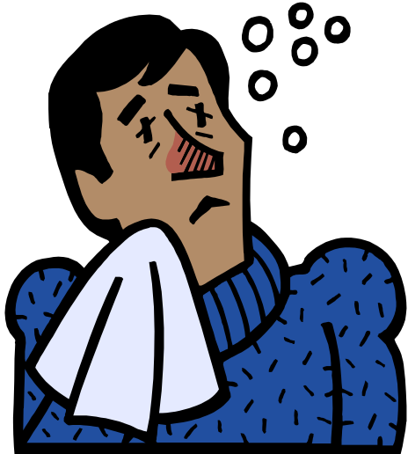
Awareness
Make it a requirement to get a
Flu shot.
Make it mandatory to get a Flu shot
when applying for a passport.
Inform people as to how to prevent the disease and how it can be transmitted.

Slide 12
MRSA
(Methicillin-resistant Staphylococcus aureus )
Is an infection that is caused by a strain of staph bacteria that's become resistant to the antibiotics commonly used to treat ordinary staph infections.
Are commonly found in people who have been in nursing homes, schools, or hospitals

Slide 13

Transmission
Can spread easily through cuts and abrasions
Skin-on-skin contact
Overcrowded areas
Certain medical procedures, such as tubing, can act as pathways for MRSA

Slide 14

Treatment
Antibiotics
Doctors can drain superficial abscesses

Slide 15
Prevention
Wash your hands
Keep wounds covered
Use peroxide to clean out a wound, or Neosporin
Disinfect door handles and personal items
Shower after athletic practices or games
Wash your clothes if you get a cut, you never know where the virus can be lurking!

Slide 16
Awareness
Inform Athletic team or extra curricular clubs about this infection
If you have MRSA stay away from any public location
Inform schools and workplaces of this infection
Put “Wash Your Hands” posters in bathrooms

Slide 17
AIDS
Is not only a sexually transmitted disease
Is one of the most deadly diseases known to man
Attacks the immune system
Caused by an immunodeficiency virus(HIV)
THERE IS NO CURE

Slide 18

Transmission
Unprotected sexual intercourse
Infected blood
Mother to a fetus
Breast feeding
Child birth

Slide 19
Treatment
Nucleoside reverse transcriptase inhibitors (NRTIs)
Non-nucleoside reverse transcriptase inhibitors (NNRTIs)
Protease inhibitors (Pis)
Integrase inhibitors
Entry or fusion inhibitors

Slide 20
Prevention
When working with needles, do not prick yourself
Have protected sexual intercourse and know if your partner has and STD
If you are pregnant, get medical attention RIGHT AWAY

Slide 21

Awareness
Inform teenagers and adults on this disease.
In school, have a sex education class or health class
Make sure doctors have puncture proof gloves

